Slide 1
Object Oriented Programing(OOPS)
Presented By:Er Sudan Prajapati

Slide 2
What is OOPS?
OOPS is a design philosophy.
It stands for Object Oriented Programming.
OOPS is a new approach to creating computer application that seeks to solve procedural programing(functional programing)
OOPS is a programming model where programs are organized around objects and data rather than action and logic.
OOP allows decomposition of a problem into a number of entities called objects and then builds data and functions around objects.
In OOP only a small semantic gap willexist between reality and model

Slide 3
In order to clearly understand the object orientation, let’s take of "hand” as an example.
The “hand” is a class.
Your body has two objects of type hand, named left hand and right hand.
Their main functions are controlled/ managed by a set of electrical signals sent through your shoulders (through an interface).
So the shoulder is an interface which your body uses to interact with your hands.
The hand is a well architected class.
The hand is being re-used to create the left hand and the right hand by slightly changing the properties of it.

Slide 4
The most prominent qualities of OOPS are:
Understanding of the system is easier as the semantic gap between the system and reality is small.
Modifications to the system tends to be local as they often result from the individual item which is represented as single object.

Slide 5
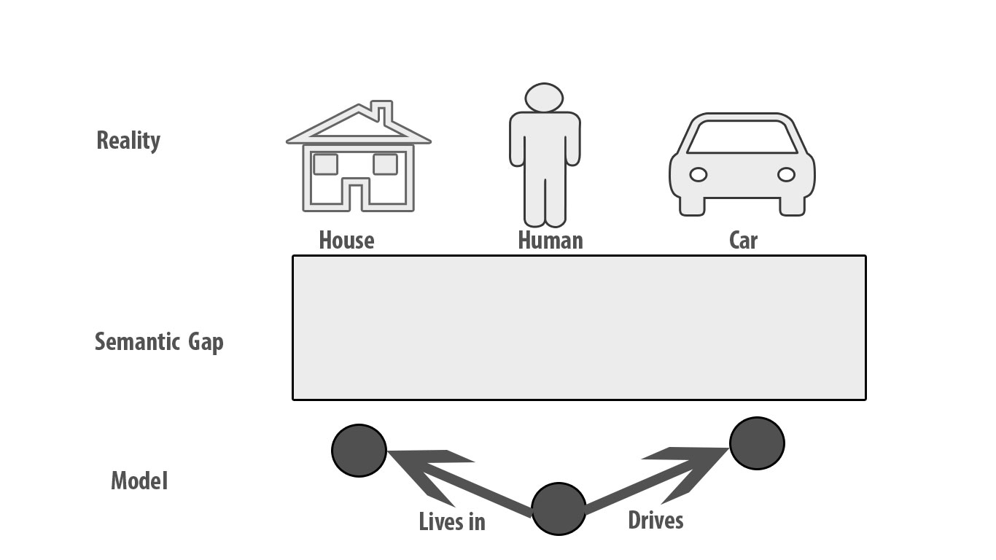

Slide 6
What is an Object?
An object is a building block of OOP .
An object can be considered a "thing" that can perform a set of related activities.
The set of activities that the object performs defines the object's behavior.
For example, the hand can grip something or a Student (object) can give the name or address.
In pure OOP terms an object is an instance of a class.

Slide 7
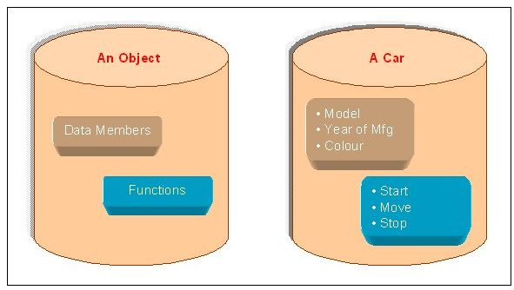

Slide 8
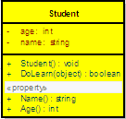
What is an Class?
A class is simply a representation of a type of object.
It is the blueprint/ plan/ template that describe the details of an object.
A class is the blueprint from which the individual objects are created.
Class is composed of three things:
name
attributes
operations.

Slide 9
Syntax
class classname
{
[varaibles declaration: ]
[ methods declaration: ]
}
Class is a keyword and classname is any valid c# identifier.
Everything inside the square brackets are optional .

Slide 10
Example
Syntax:
class Student{
public string name;
int roll_number;
}
Svm(){
Student studentObject =new Student();
StudentObject.name=“Suman”;
CW(“the name of student{0}”, StudentObject.name)
}

Slide 11
Adding Variables
Data is encapsulated in a class by placing data fields inside the body of class definition.
These varaibles are called instance varaible.
Instance varaibles are created whenever an object of the class is instantiated.
Example
Class Rectangle{
int length;
int width;
}

Slide 12
Adding Methods
A class with only data fields and without methods that operate on that has no life.
Methods are necessary for manipulating the data contained in the class.
Methods are declared inside the body of the class usually after the declaration of instance varaibles.
Syntax:
type methodname (parameter-list){
method-body;
}

Slide 13
Example
Class Rectangle{
int length;
Int width;
public void GetData(int x, int y)
{
length = x;
width = y;
}
public int RectArea(){
Int area = length * width;
}
}

Slide 14
Creating Objects
An object in C# is essentially a block of memory that contains space to store all the instance variables.
Creating an object is also referred to as instantiating an object.
Object in C# are created using the new operator.
The new operator creates an object of the specified class and returns a reference to that object.
Example
Rectangle rect1=new Rectangle();

Slide 15
Declare
Rectangle rect1=new Rectangle();
rect1
Rectangle Object

Slide 16
Acessing Class Members
Each object in C# contains its own set of variables .
Values should be assigned in order to use them.
Outside the class the instance variables and methods cannot be accesses directly.
To access the dot operator is used.
objectname.VaraibleName;
objectname.methodname(parameter-list)
Objectname is the name of the object
Varaible name is the name of the instance variable inside the objecr
Method name is the name of the we wish to call.

